Slide 1
Assignment 2-B TurtleBot3 Teleop & OLC Analysis
GROUP 1
Chinmay Vilas Samak
Tanmay Vilas Samak
GitHub Repository

Slide 2
Overview
Teleop: teleoperate the robot using remote PC keyboard
Circle
Move robot in circle with specified constant twist command
Radius of circle determined by ratio of linear and angular velocities (kinematic formulation)
Wait (delay) 4 seconds for simulation to initialize properly
Simulate for robot’s one complete traversal around the circle (kinematic formulation)
Square
Move robot in square with specified constant twist command
Side length of square specified as a constant parameter (0.5 m) in script
Wait (delay) 4 seconds for simulation to initialize properly
Simulate for robot’s one complete traversal around the square (kinematic formulation)
Speed variation hypothesis: as speed increases, trajectory profile will deviate further from ideal

Slide 3
Implementation
Robot | launch robot from turtlebot3_bringup package
Teleop | run teleop_keyboard from turtlebot3_teleop package
Circle | argument defaults: lin_vel = 0.1, ang_vel = 0.1
Launch circle_node from assignment_1c package
Launch rviz2 from rviz2 package and load configuration file from assignment_1c package
Square | argument defaults: lin_vel = 0.1, ang_vel = 0.1
Launch square_node from assignment_1c package
Launch rviz2 from rviz2 package and load configuration file from assignment_1c package
Move | argument defaults: maneuver = circle, lin_vel = 0.1, ang_vel = 0.1
Launch circle_node or square_node from assignment_1c package depending on maneuver argument
Launch rviz2 from rviz2 package and load configuration file from assignment_1c package

Slide 4




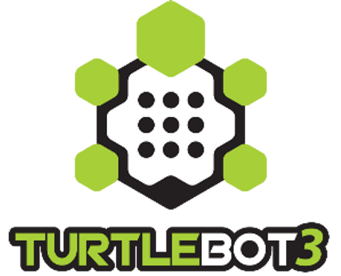
Dependencies
TurtleBot3 Burger Robot Hardware with TurtleBot3 SBC Image
ROS2 Foxy Fitzroy on Ubuntu 20.04 Focal Fossa
TurtleBot3 Packages - Included with the assignment repository
TurtleBot3 Simulations Packages - Included with the assignment repository
TurtleBot3 Messages Package - Included with the assignment repository
TurtleBot3 Dynamixel SDK Packages - Included with the assignment repository
Source: Ubuntu
Source: ROS2 GitHub
Source: ROS2 Docs
Source: GazeboSim
Source: ROBOTIS Inc.

Slide 5
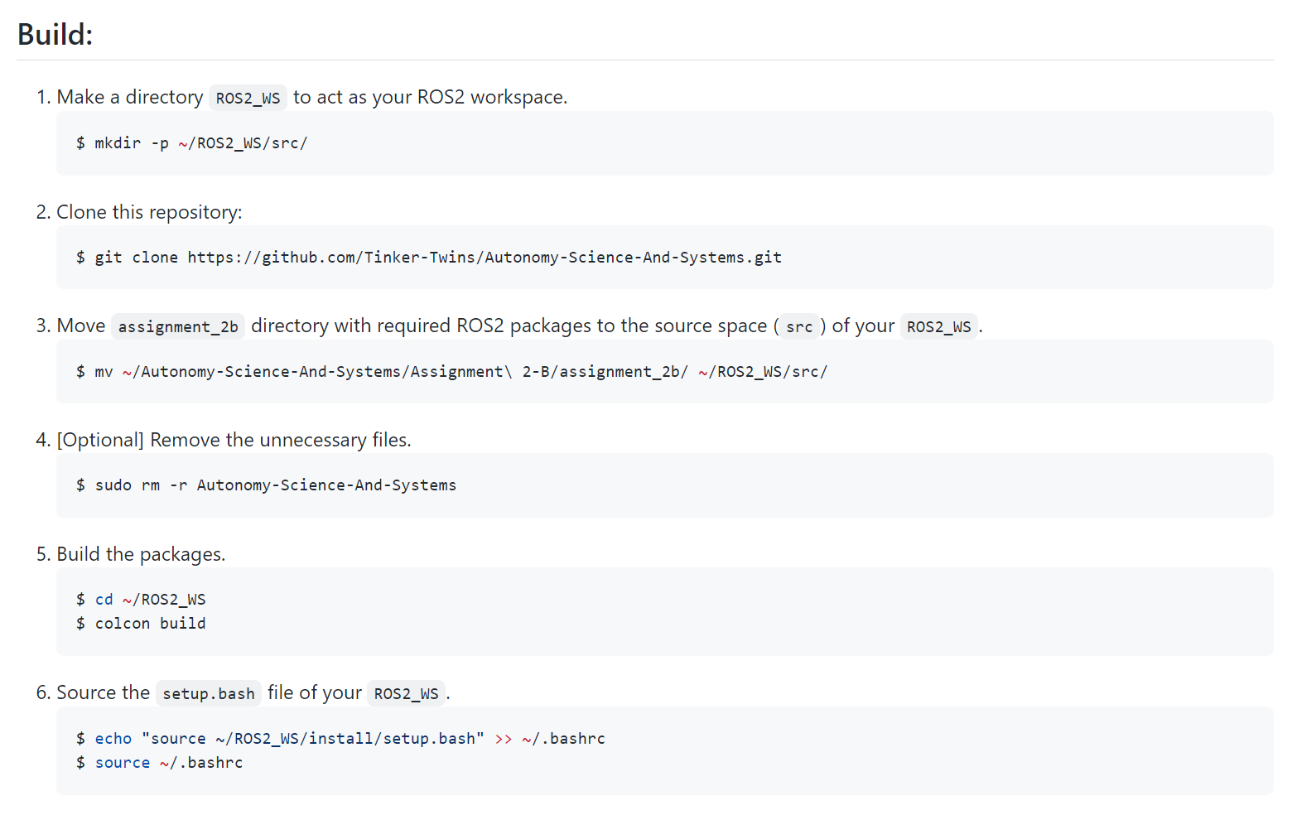
Build Instructions
Make a directory ROS2_WS to act as your ROS2 workspace.
Clone the assignment repository.
Move assignment_1c directory to src of your ROS2_WS.
[Optional] Remove the unnecessary files.
Build the packages.
Source the setup.bash file of your ROS2_WS.
NOTE: Detailed instructions are available
in README.md file of the assignment repository.
Source: Tinker Twins GitHub

Slide 6
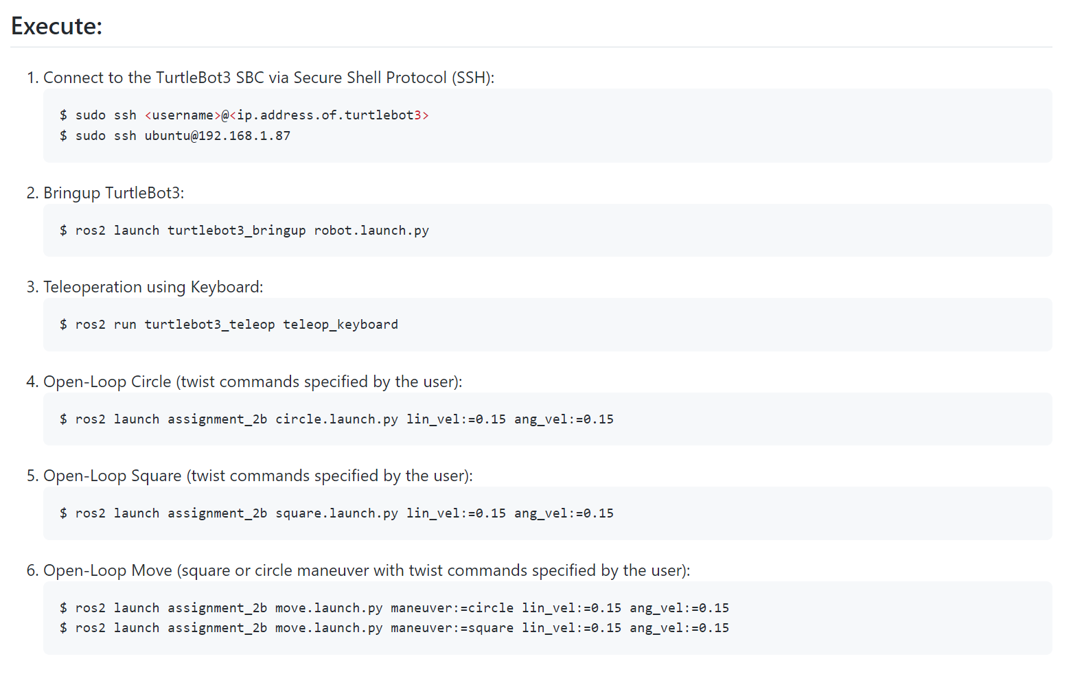
Execution Instructions
Robot: Launch robot.launch.py file from turtlebot_bringup package
Teleop: Run teleop_keyboard executable from turtlebot3_teleop package
Circle
Launch circle.launch.py file from assignment_1c package
Provide arguments for lin_vel and ang_vel (float)
Square
Launch square.launch.py file from assignment_1c package
Provide arguments for lin_vel and ang_vel (float)
Move
Launch move.launch.py file from assignment_1c package
Provide argument for maneuver (string)
Provide arguments for lin_vel and ang_vel (float)
NOTE: Detailed instructions are available in README.md file of the assignment repository.
Source: Tinker Twins GitHub

Slide 7
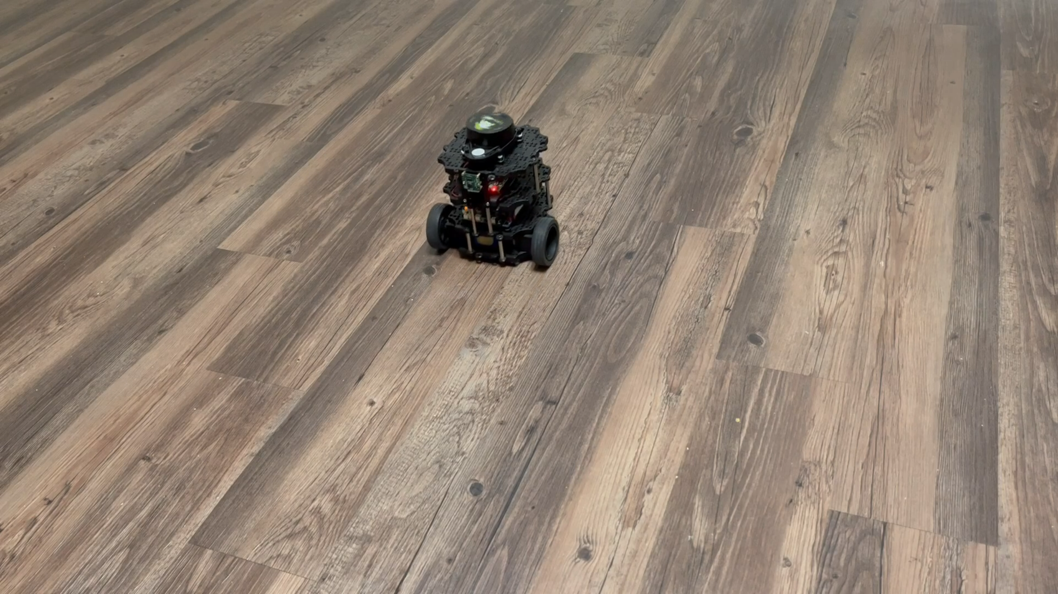
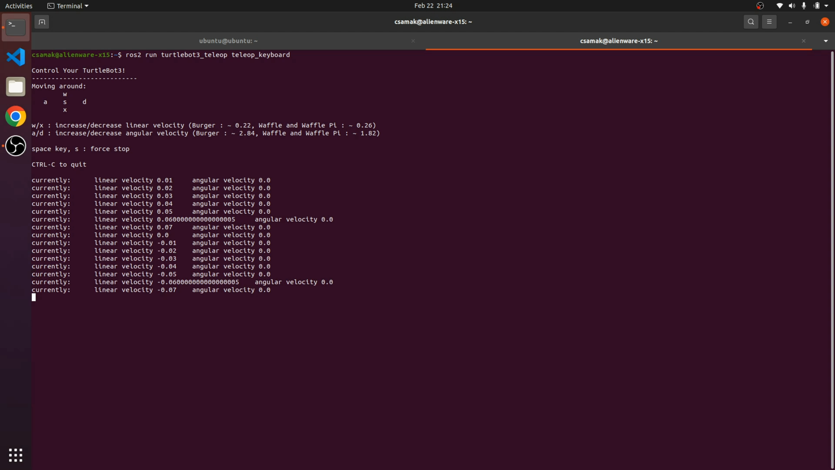
Results - Teleop

Slide 8
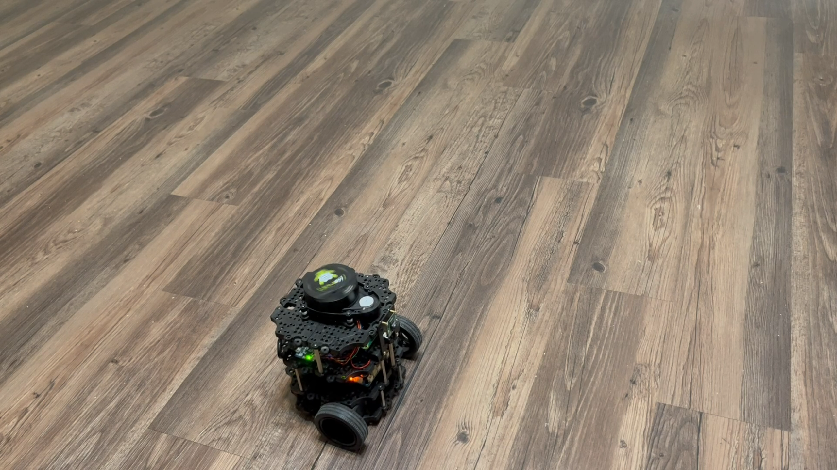
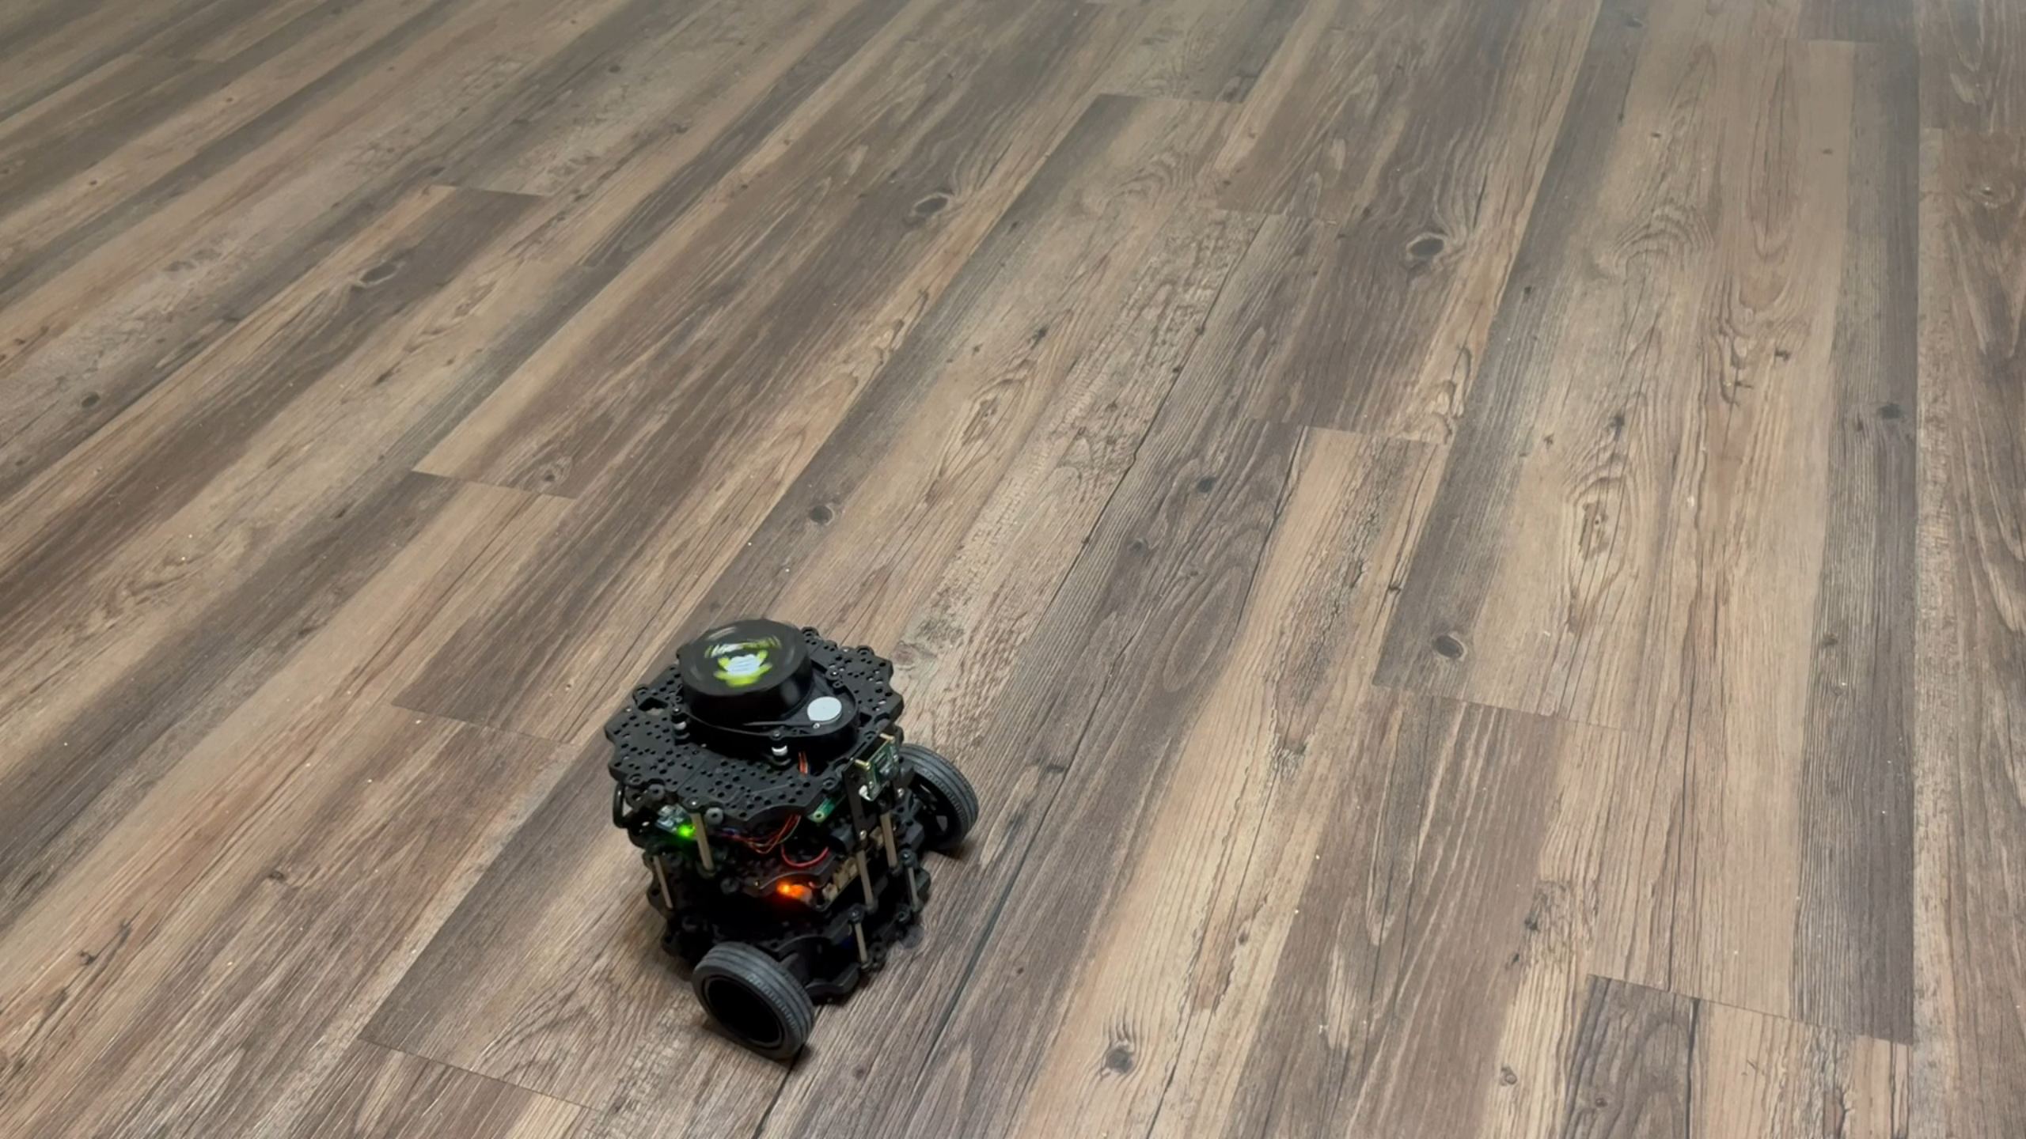
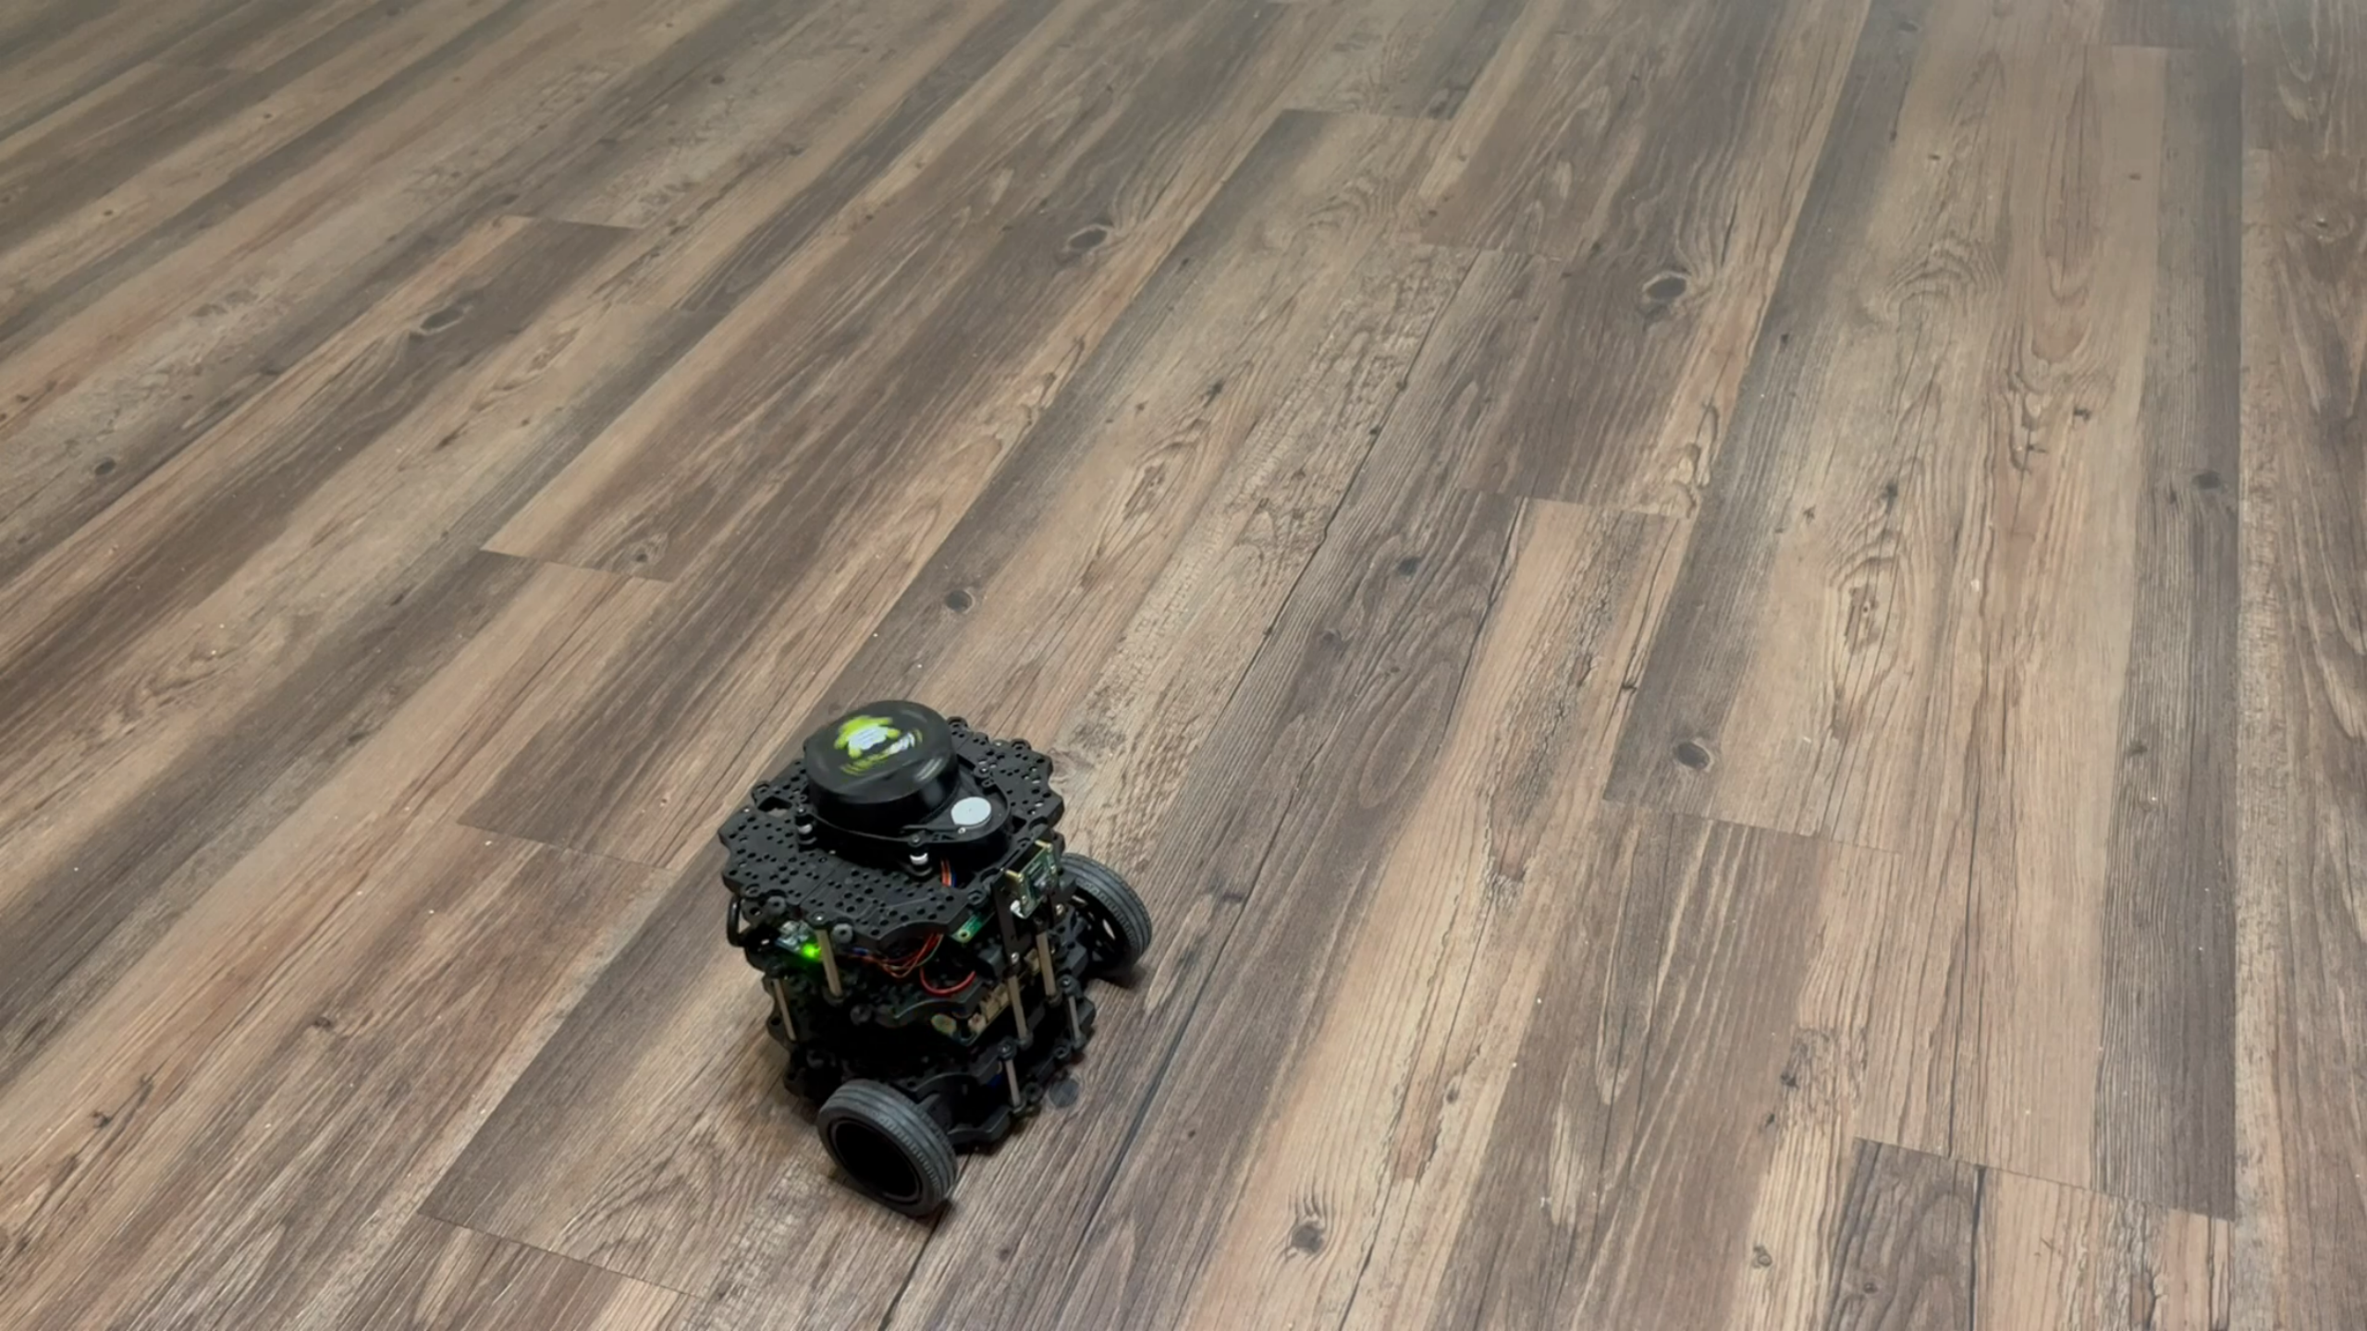
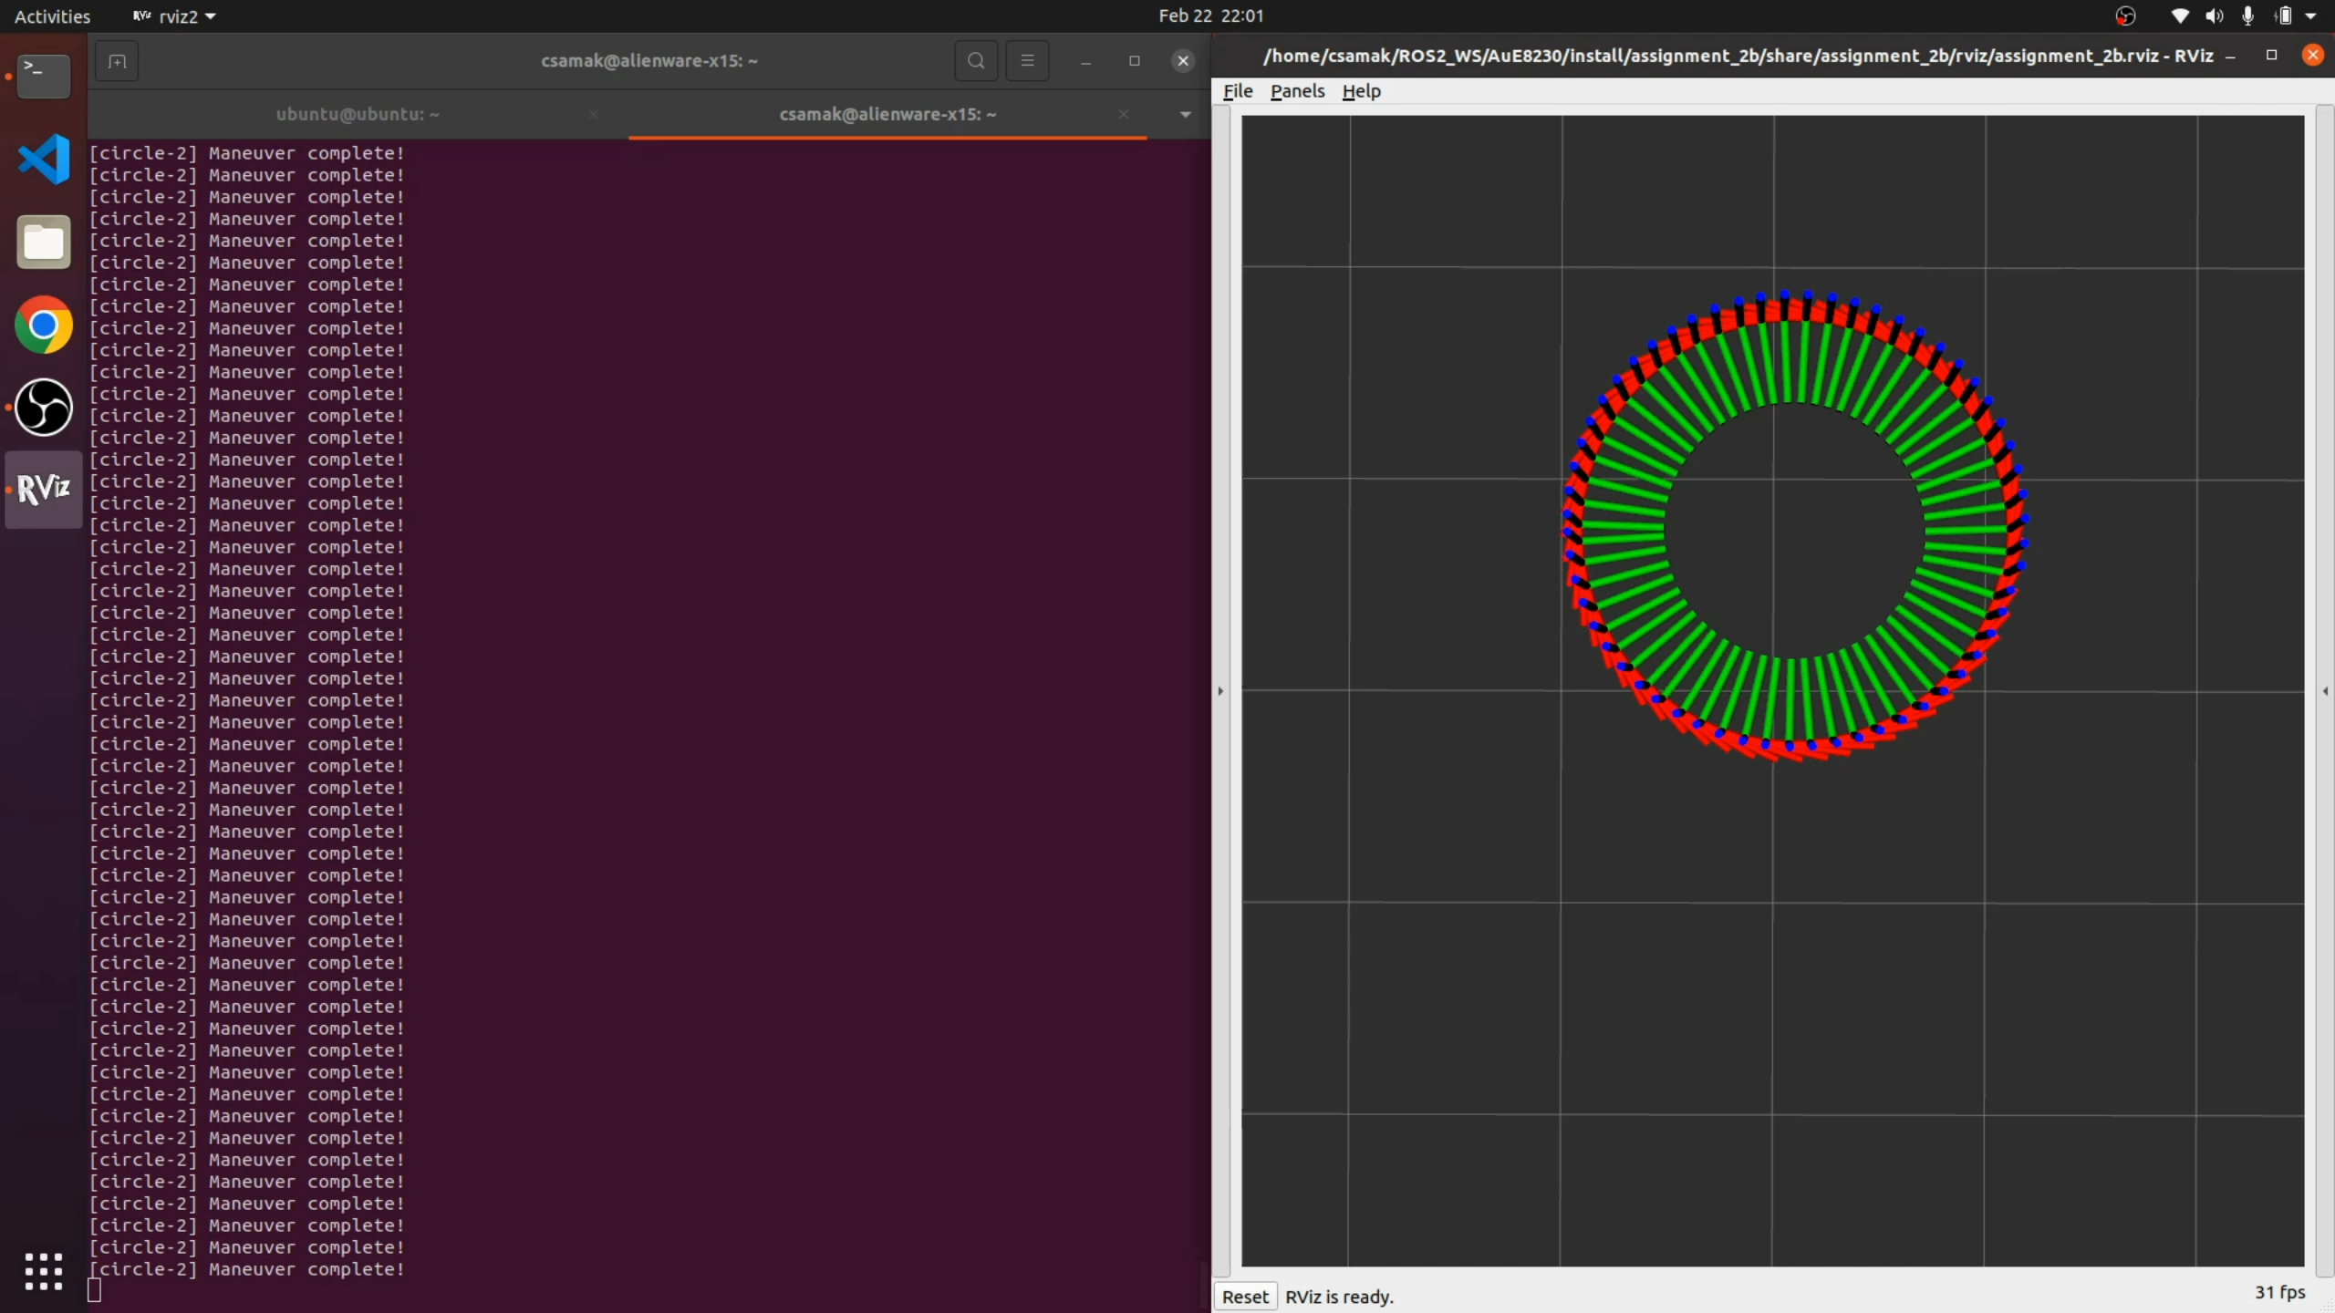

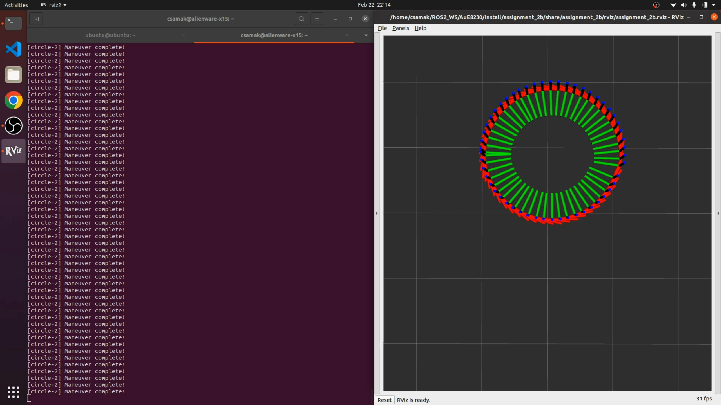
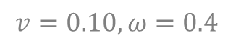
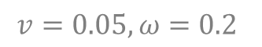
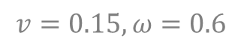
Results - Circle
Slow
Medium
Fast
Robot
RViz
$$v=0.05, ω=0.2$$
$$v=0.10, ω=0.4$$
$$v=0.15, ω=0.6$$

Slide 9
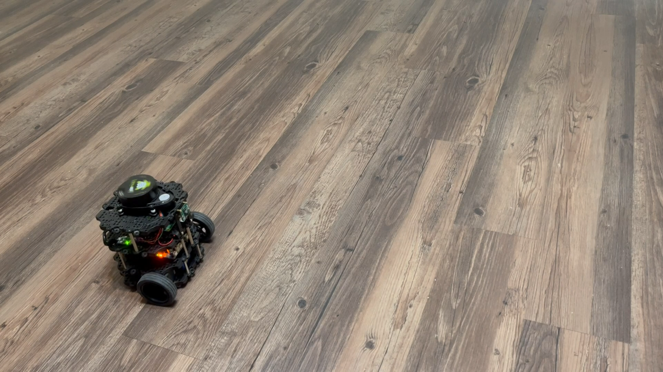
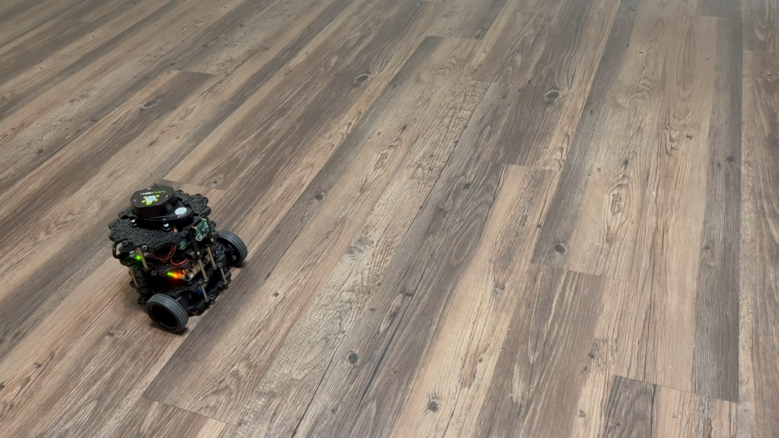
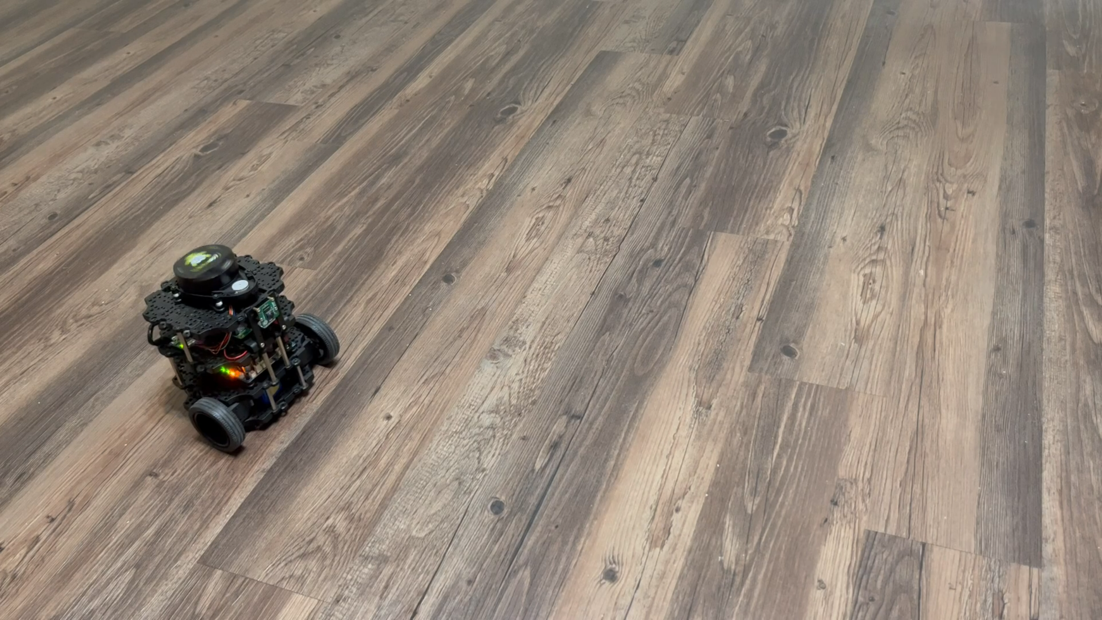
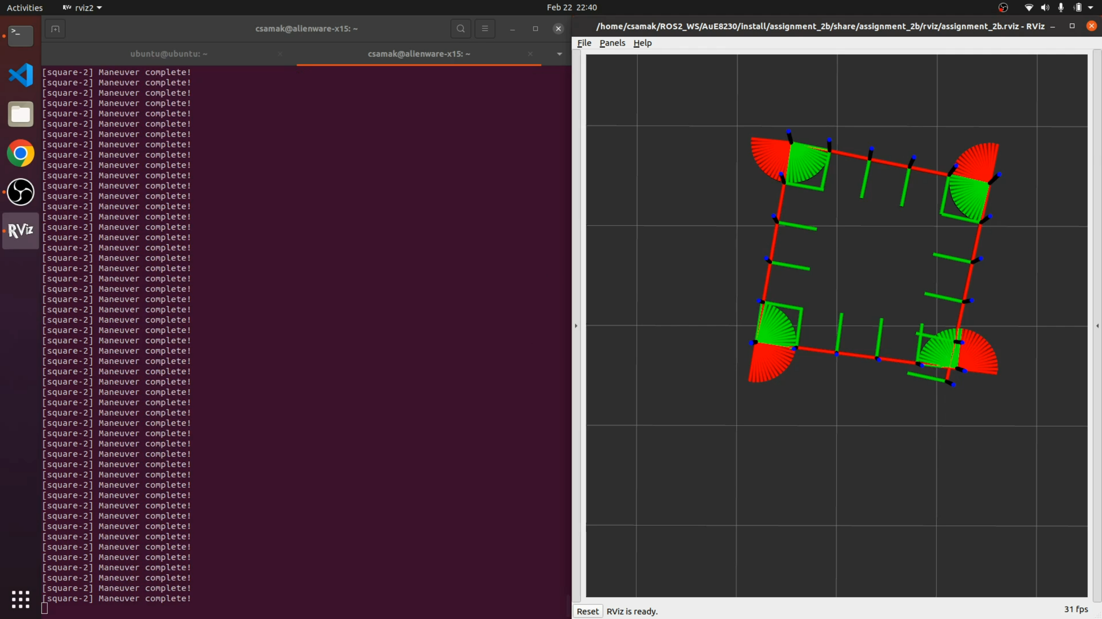
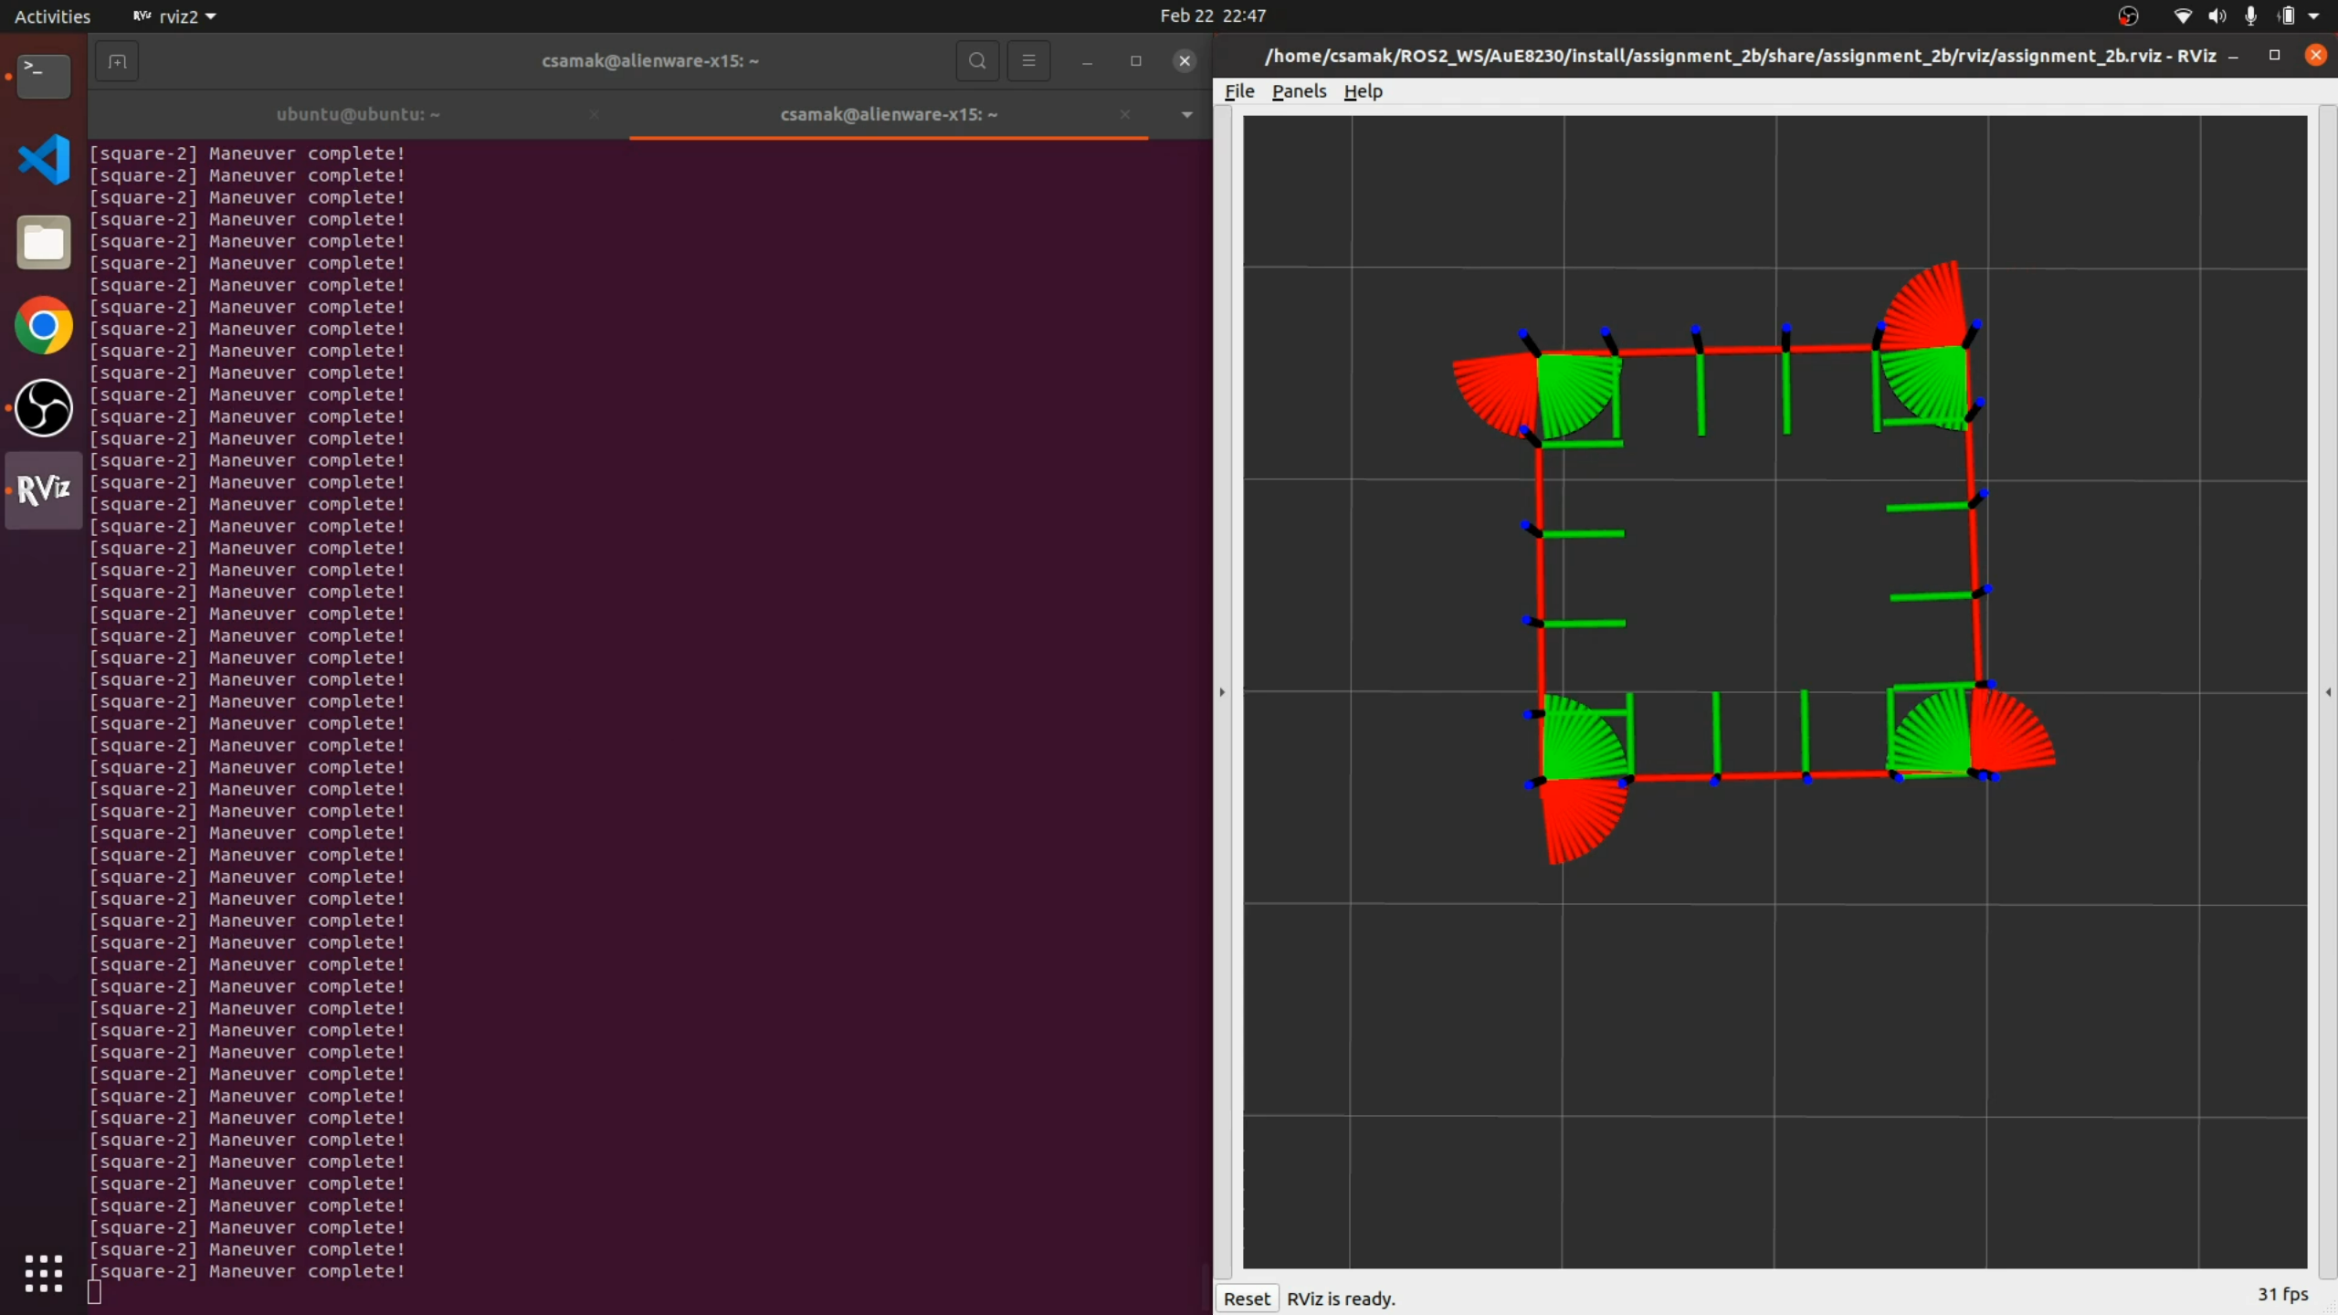
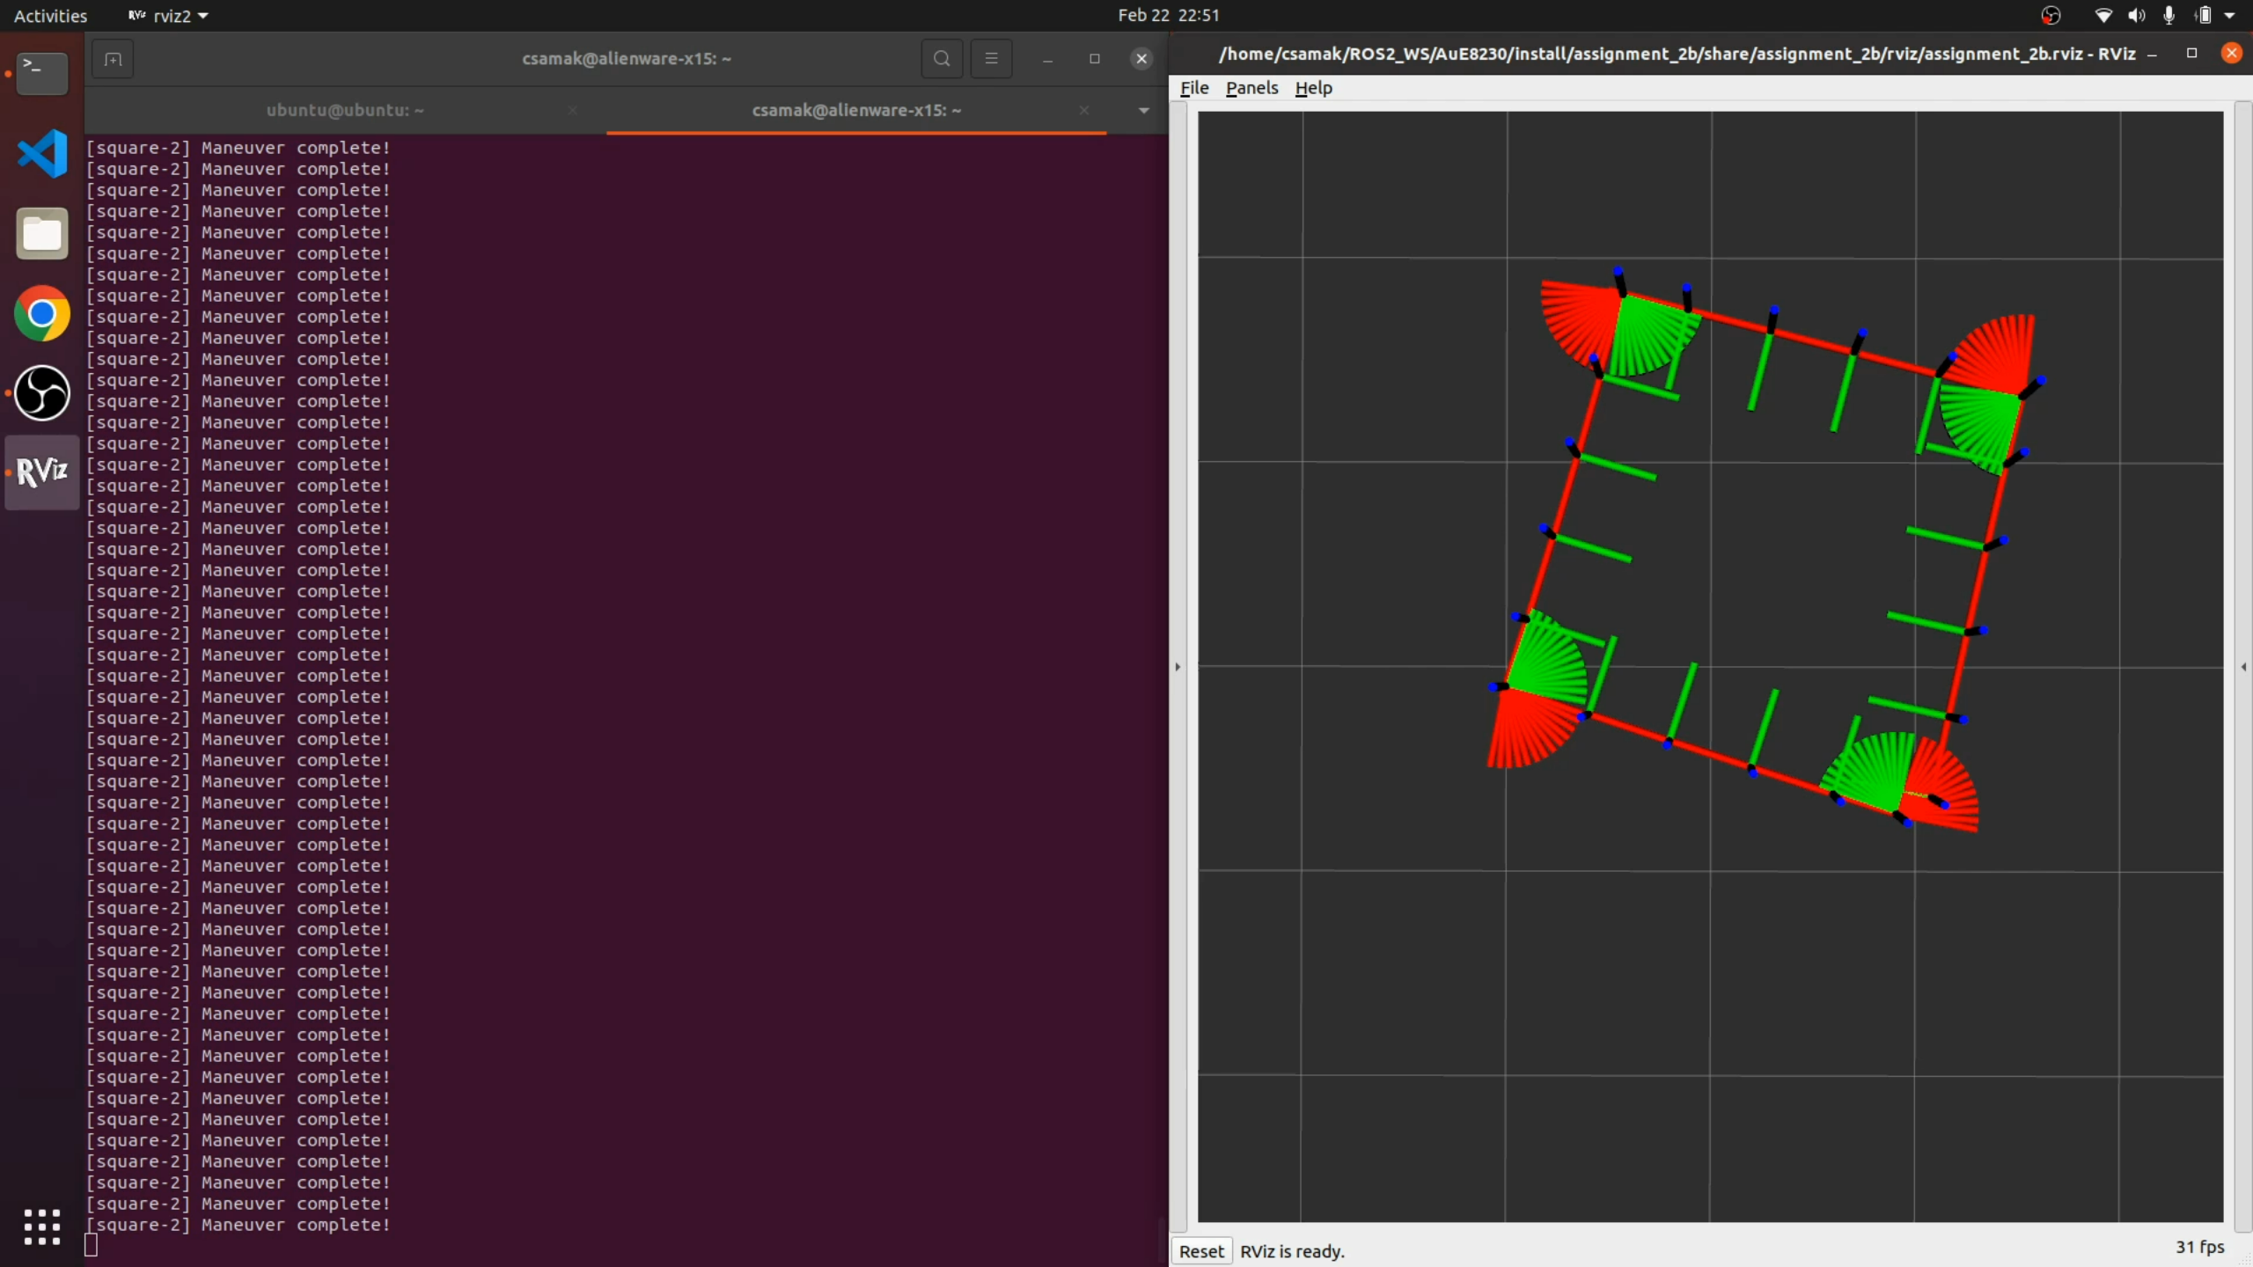
Results - Square
Slow
Medium
Fast
Robot
RViz
$$v=0.05, ω=0.2$$
$$v=0.10, ω=0.4$$
$$v=0.15, ω=0.6$$

Slide 10
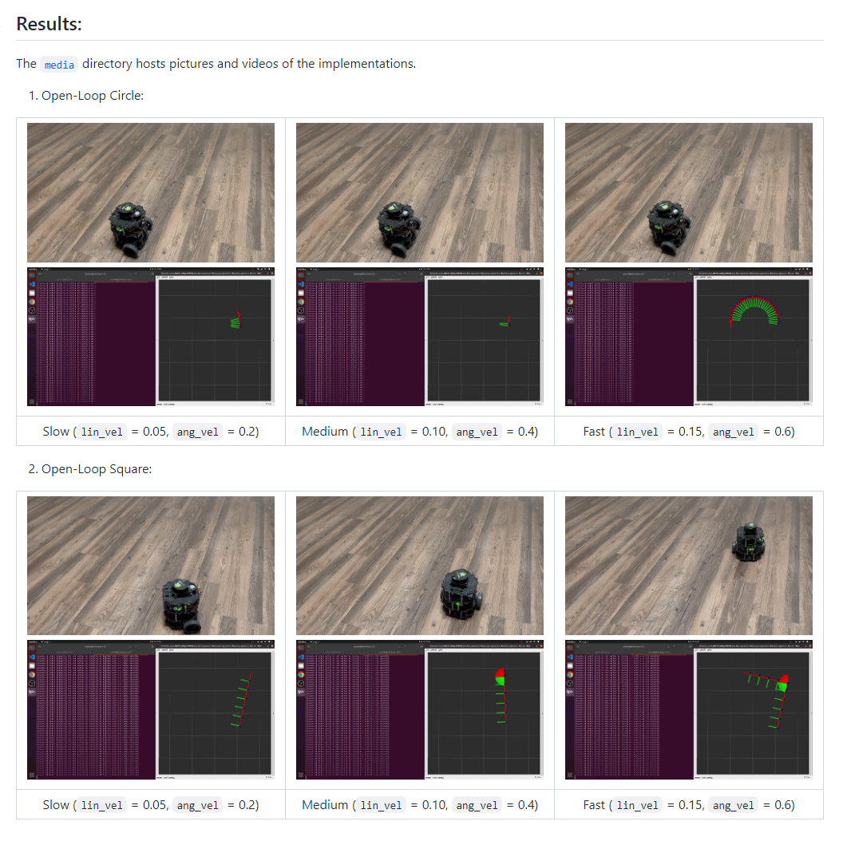
Analysis
Parameter/Metric | Slow Circle | Slow Square | Medium Circle | Medium Square | Fast Circle | Fast Square
Resemblance to ideal trajectory | Very High | Low | High | Medium | Medium | Extremely Low
Kinematic behavior | Very High | High | High | Medium | Medium | Very Low
Time for 1 complete traversal | High | Very High | Medium | Medium | Very Low | Low
Note 1: The analysis presented above is qualitative.
Although a detailed quantitative analysis can be accomplished, it was beyond the scope of this assignment.
Note 2: Deployment videos as well as pictures are available in README.md file as well as in the media directory of the
assignment repository.
Source: Tinker Twins GitHub

Slide 11
Thank You!

